Slide 1
What is Software Engineering?

Slide 2
What is Software Engineering?
Software Engineering is the process of designing, developing, testing, and maintaining software.
It is a systematic and disciplined approach to software development that aims to create high-quality, reliable, and maintainable software.
It includes a variety of techniques, tools, and methodologies, including requirements analysis, design, testing, and maintenance.

Slide 3
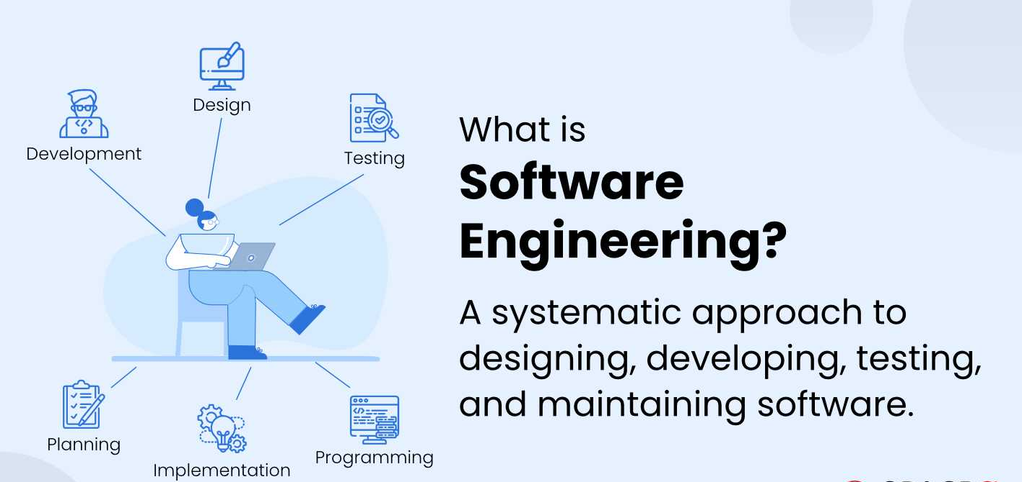
What is Software Engineering?

Slide 4
What is SDLC?
Software Development Life Cycle (SDLC) is a structured process that is used to design, develop, and test high-quality software. SDLC, or software development life cycle, is a methodology that defines the entire procedure of software development step-by-step. The goal of the SDLC life cycle model is to deliver high-quality, maintainable software that meets the user's requirements.
Common phases of SDLC :
Requirements
Design
Implementation
Testing
Deployment
Maintenance

Slide 5
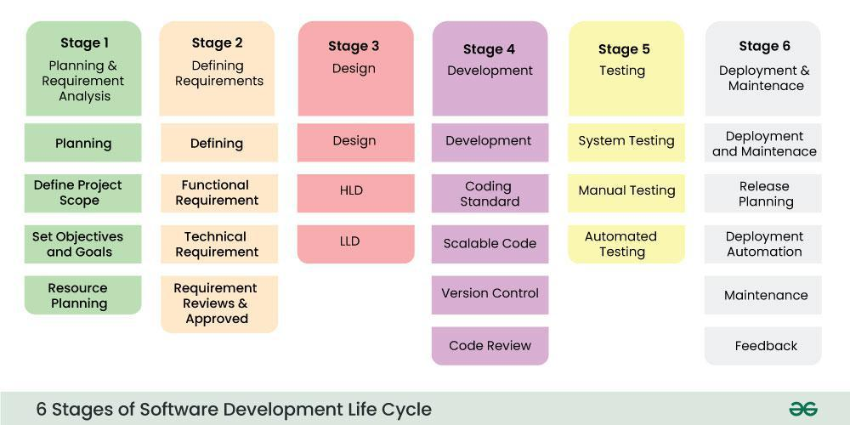
6 Phases of SDLC

Slide 6
SDLC (Agile, Waterfall, DevOps)

Slide 7
SDLC Models
SDLC models provide different approaches/methodologies for managing development.
Some popular models are :
Waterfall – Traditional, linear approach
Agile – Iterative, flexible, customer-centric
DevOps – Continuous development + deployment + operations

Slide 8
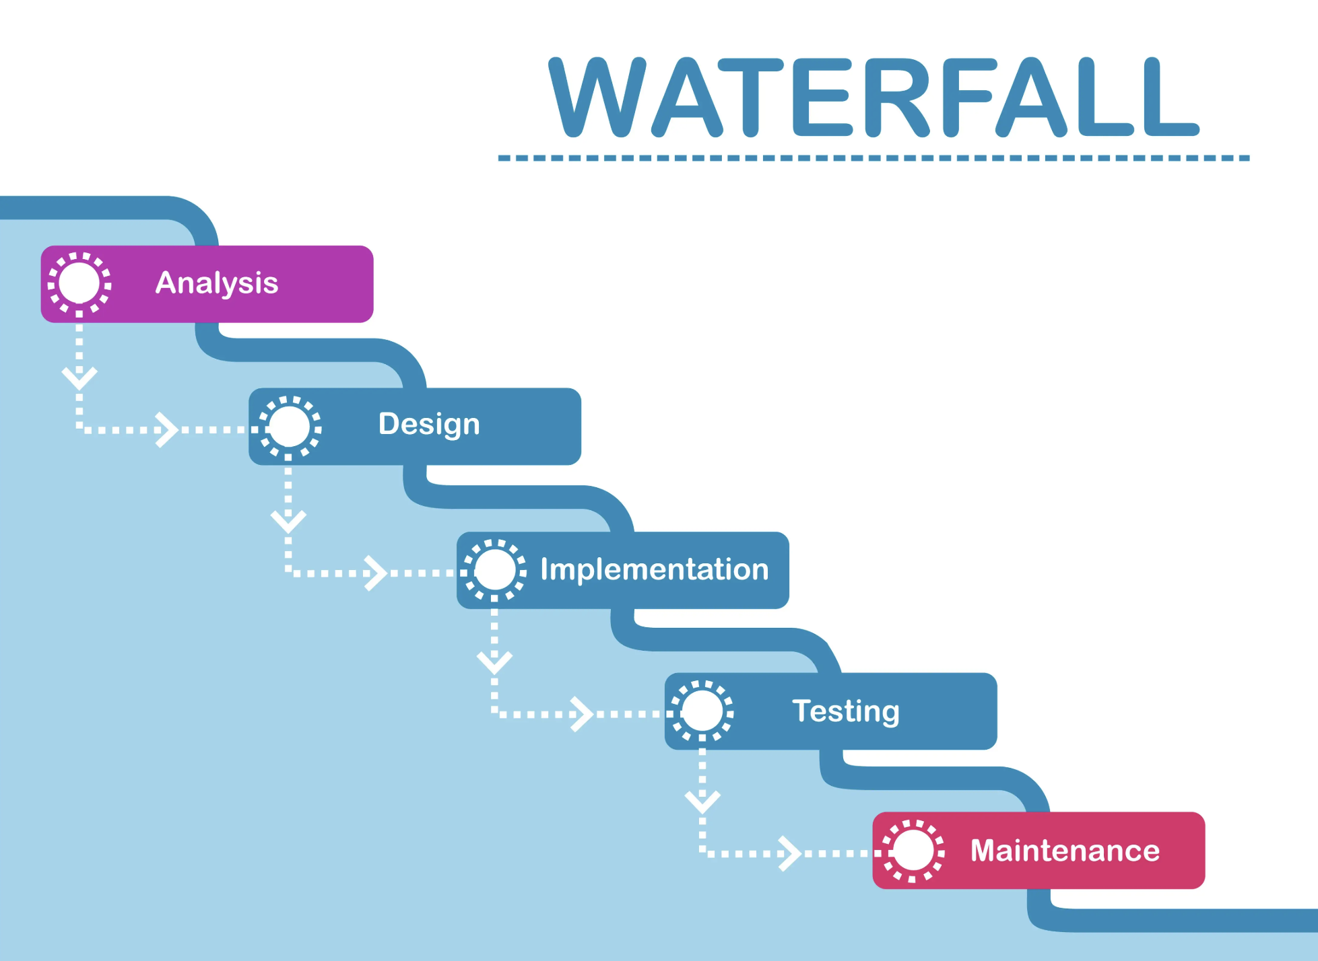
Waterfall Model
Advantages:
Easy to manage
Clear milestones & documentation
Works for small, predictable projects
Disadvantages:
Inflexible, poor at handling change
Testing late, higher risk
User feedback at the end
The Waterfall Model is a Traditional Software Development Methodology. It was first introduced by Winston W. Royce in 1970. It is a linear and sequential approach to software development that consists of several phases.
Oldest and simplest model
Sequential phases, one after another
Works when:
Requirements are clear & stable
Minimal changes expected
Small projects with fixed scope

Slide 9
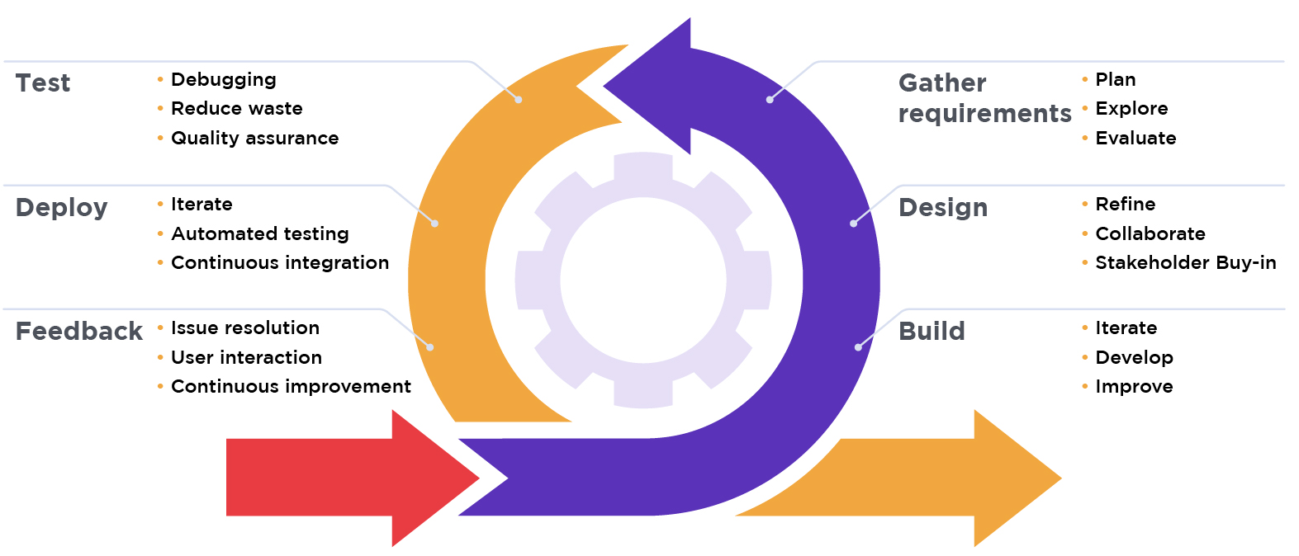
Agile Model
The Agile Model is an iterative and incremental approach to software development. Instead of delivering the whole product at once, the project is divided into small, manageable parts (sprints/iterations).
Each sprint typically lasts 2–4 weeks and results in a working piece of software. Emphasizes flexibility, customer collaboration, and continuous delivery.
Advantages:
Flexible, adapts to change
Early, continuous delivery
Strong customer collaboration
Reduces risks via small increments
Disadvantages:
Needs skilled teams
Can lead to scope creep
Less focus on formal documentation
Stages of Agile Model

Slide 10
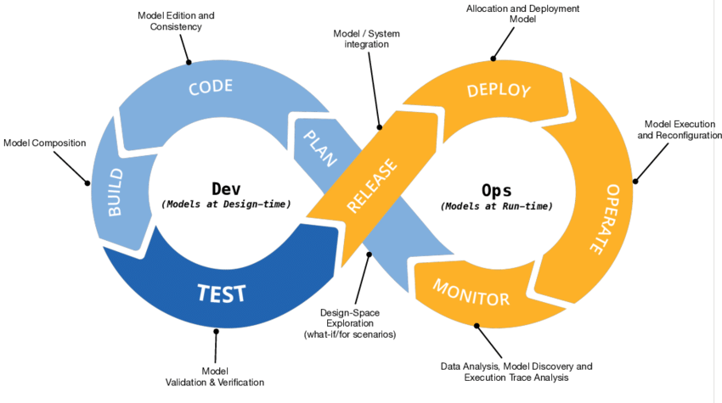
DevOps Model
DevOps combines development (Dev) and operations (Ops) to increase the efficiency, speed, and security of software development and delivery compared to traditional processes.
A nimbler software development lifecycle results in a competitive advantage for businesses and their customers.
Stages of DevOps Model
Advantages:
Faster releases
Automated testing & deployment
Improves collaboration
Enhanced monitoring & quick fixes
Disadvantages:
Needs tools & infra investment
Cultural change required
CI/CD complexity

Slide 11
Stages of SDLC

Slide 12
Stages of SDLC
The primary goal of the SDLC process is to produce cost-efficient and high-quality products. The process comprises a detailed plan that describes how to develop, maintain, and replace the software. All are listed below -
Planning
Analysis
Design
Development/Coding
Testing
Deployment
Maintenance

Slide 13
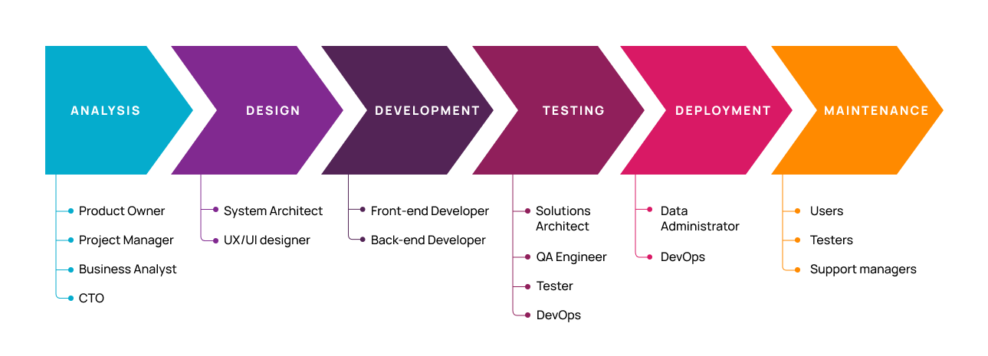
Phases of SDLC

Slide 14
Stage 1: Project Planning
The first stage of SDLC is all about “What do we want?” Project planning is a vital role in the software delivery lifecycle since this is the part where the team estimates the cost and defines the requirements of the new software.
Stage 2: Gathering Requirements & Analysis
The second step of SDLC is gathering maximum information from the client requirements for the product. Discuss each detail and specification of the product with the customer. The development team will then analyze the requirements keeping the design and code of the software in mind.
Further, investigating the validity and possibility of incorporating these requirements into the software system. The main goal of this stage is that everyone understands even the minute detail of the requirement. Hardware, operating systems, programming, and security are to name the few requirements.

Slide 15
Stage 3: Design
In the design phase (3rd step of SDLC), the program developer scrutinizes whether the prepared software suffices all the requirements of the end-user. Additionally, if the project is feasible for the customer technologically, practically, and financially. Once the developer decides on the best design approach, he then selects the program languages like Oracle, Java, etc., that will suit the software.
Once the design specification is prepared, all the stakeholders will review this plan and provide their feedback and suggestions. It is absolutely mandatory to collect and incorporate stakeholder’s input in the document, as a small mistake can lead to cost overrun.

Slide 16
Stage 4: Coding or Implementation
Time to code! It means translating the design to a computer-legible language. In this fourth stage of SDLC, the tasks are divided into modules or units and assigned to various developers.
The developers will then start building the entire system by writing code using the programming languages they chose. This stage is considered to be one of the longest in SDLC. The developers need certain predefined coding guidelines, and programming tools like interpreters, compilers, debugger to implement the code.
The developers can show the work done to the business analysts in case if any modifications or enhancements required.

Slide 17
Stage 5: Testing
Once the developers build the software, then it is deployed in the testing environment. Then the testing team tests the functionality of the entire system. In this fifth phase of SDLC, the testing is done to ensure that the entire application works according to the customer requirements.
After testing, the QA and testing team might find some bugs or defects and communicate the same with the developers. The development team then fixes the bugs and send it to QA for a re-test. This process goes on until the software is stable, bug-free and working according to the business requirements of that system.

Slide 18
Stage 6: Deployment
The sixth phase of SDLC: Once the testing is done, and the product is ready for deployment, it is released for customers to use. The size of the project determines the complexity of the deployment.
The users are then provided with the training or documentation that will help them to operate the software. Again, a small round of testing is performed on production to ensure environmental issues or any impact of the new release.
Stage 7: Maintenance
The actual problem starts when the customer actually starts using the developed system and those needs to be solved from time to time. Maintenance is the seventh phase of SDLC where the developed product is taken care of. According to the changing user end environment or technology, the software is updated timely.

Slide 19
Writing Clean & Maintainable Code
Coding standards

Slide 20
What are Coding Standards?
Coding standards are a set of rules, guidelines, and best practices that developers follow to write consistent, clean, and maintainable code. They ensure that code is easy to read, understand, debug, and extend by any team member.
Importance of Coding Standards
Improve readability and understandability of code.
Enable team collaboration by keeping code style consistent.
Reduce bugs and make debugging easier.
Increase maintainability and long-term project health.
Support scalability by ensuring code can grow with fewer issues.

Slide 21
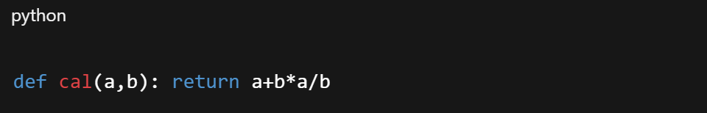
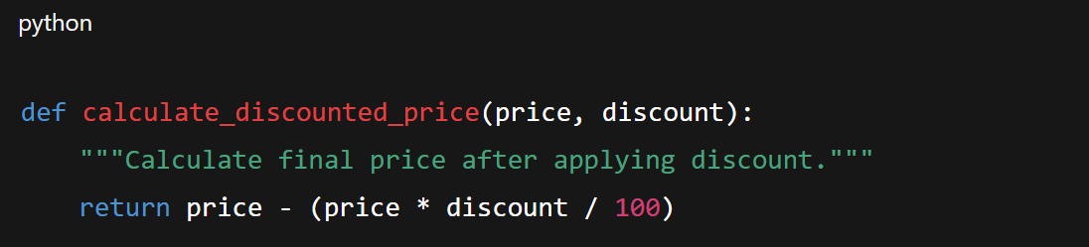
Bad Code vs Good Code
Bad practice:
Good practice:

Slide 22
Common Coding Standards
Naming Conventions – Use meaningful and descriptive names for variables, functions, classes, and files. Follow consistent styles like camelCase, PascalCase, or snake_case.
Indentation & Formatting – Maintain consistent indentation (spaces/tabs), line length, and spacing around operators for better readability.
Comments & Documentation – Use inline comments sparingly, write docstrings for functions and classes, and maintain external documentation.
Error Handling & Exceptions – Always handle errors gracefully with try-catch blocks and meaningful error messages instead of crashing programs.
Code Reusability – Avoid duplication by writing modular, reusable functions and components. Follow the DRY (Don’t Repeat Yourself) principle.
Security Practices – Validate all user inputs, avoid hardcoding sensitive data (like passwords or API keys), and follow secure coding practices.
Testing Practices – Write unit tests, integration tests, and maintain test coverage to ensure reliability.
Code Reviews – Encourage peer reviews to catch mistakes early, improve quality, and share knowledge within the team.

Slide 23
Using Comments for More Clarity

Slide 24
What are Comments?
Comments are notes written in the code that explain what the code does without affecting its execution. They provide clarity, making it easier for other developers (and your future self) to understand the logic and purpose of the code.
Importance of Comments
Improve readability and help others quickly understand the code.
Serve as documentation for complex logic, functions, or algorithms.
Help in debugging and maintenance by providing context.
Support team collaboration, especially in large projects.
Ensure that code remains understandable long after it was written.

Slide 25
Types of Comments
Inline Comments – Short explanations placed on the same line as code.
Block Comments – Multi-line explanations for sections of code.
Documentation Comments – Used for describing functions, classes, or modules in detail (e.g., docstrings in Python, Javadoc in Java).
Best Practices for Writing Comments
Keep comments clear, concise, and relevant.
Avoid stating the obvious (don’t explain trivial code).
Update comments whenever code changes.
Use comments to explain why, not just what.
Follow team or language-specific commenting style guides.

Slide 26
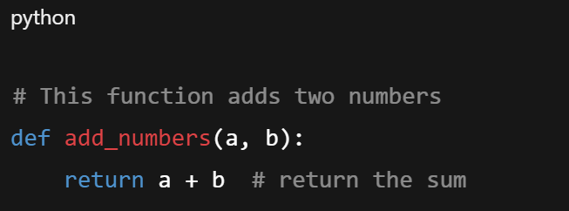
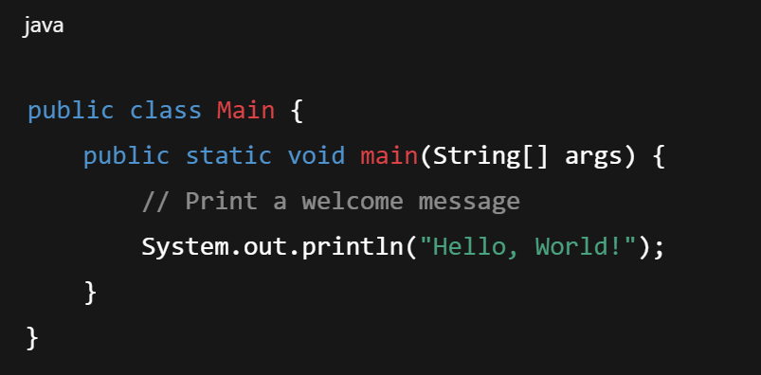
Examples of Comments
Single-line (Inline) Comments

Slide 27
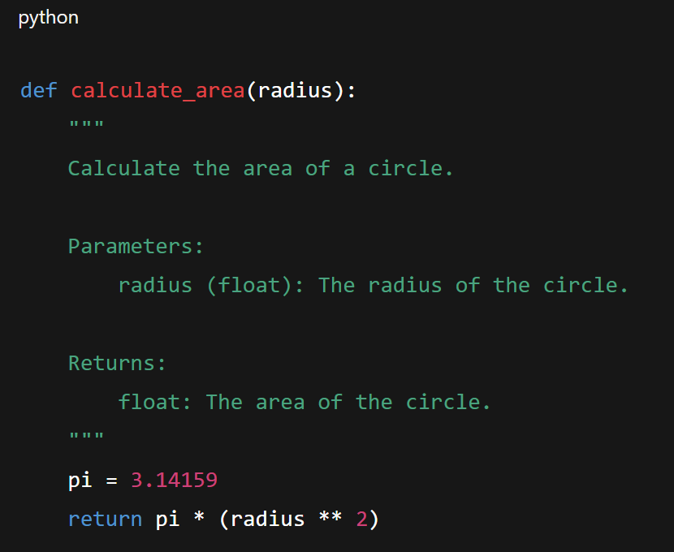
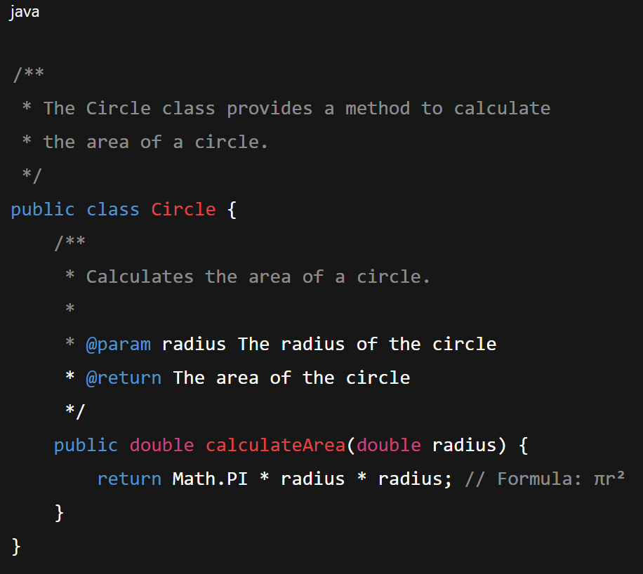
Examples of Comments
Multi-line (Block) Comment

Slide 28
What is Logging and Print?
Debugging and monitoring are essential for building reliable software.
Two common methods are using print statements or logging frameworks.
At first glance, both seem to do the same thing: display output.
However, their purpose, scope, and usage differ greatly.
Understanding the difference helps in writing cleaner, more professional code.

Slide 29
Print Statements
The print statement is the simplest way to display output during software development. It is often used to quickly test values, confirm function calls, or trace the program’s execution flow by sending messages directly to the console or terminal. Being beginner-friendly and requiring no setup, it is especially useful in small programs, quick experiments, or learning scenarios where simplicity is more important than structure or scalability.
Limitations of Print
Becomes messy and unmanageable in larger projects.
No way to classify messages by severity or importance.
Cannot selectively disable or filter specific outputs.
Difficult to track issues in production since console output is temporary.
Can slow down performance if left in loops or critical code paths.
Often requires manually removing before deploying to production.

Slide 30
Logging
A structured and configurable way of recording program events.
Allows developers to capture not just output, but context and severity.
Supports multiple levels: DEBUG, INFO, WARNING, ERROR, CRITICAL.
Logs can be stored in files, databases, servers, or monitoring dashboards.
Can include timestamps, user info, and system states for detailed tracking.
Essential in professional, team-based, or long-term software projects.
Advantages of Logging
Scalable and maintainable across small and large systems.
Provides detailed insight into errors, performance, and user behavior.
Easy to filter and analyze logs by severity or tags.
Enables monitoring tools (e.g., Splunk, ELK, Grafana) to track live systems.
Facilitates audits and compliance by keeping a history of events.
Reduces debugging time by making issues reproducible.
Can run silently in the background without disturbing the user.

Slide 31
Different levels of logging
Debug: It is used to give detailed information while debugging the program.
Info: It is used when we want to display some general information.
Warning: It is used to display some warning which might affect the program in the future.
Error: It is used to display some error message that has occurred in the program while executing.
Critical: It is used to display the message when something critical has happened to the program that has stopped its execution.

Slide 32
When to Use Which
Use print for:
Quick, temporary debugging during active development.
Simple, interactive user output in small scripts or command-line tools.
Use Logging for:
Any code intended for production use, regardless of size.
Applications requiring detailed event tracking, error reporting, and performance monitoring.
Systems where log data needs to be analyzed, stored persistently, or routed to different destinations.
When a structured and configurable approach to output is required for maintainability and scalability.

Slide 33
Print vs Logging
Feature | Print Statements | Logging
Purpose | Quick debugging, temporary checks | Debugging, monitoring, auditing
Configurable Levels | ❌ None | ✅ Multiple levels (DEBUG, INFO, etc.)
Storage | ❌ Console only | ✅ Files, databases, servers
Scalability | ❌ Poor | ✅ High (suitable for distributed systems)
Format | ❌ Plain text only | ✅ Custom formats (timestamps, context)
Production Use | ❌ Not recommended | ✅ Industry best practice

Slide 34
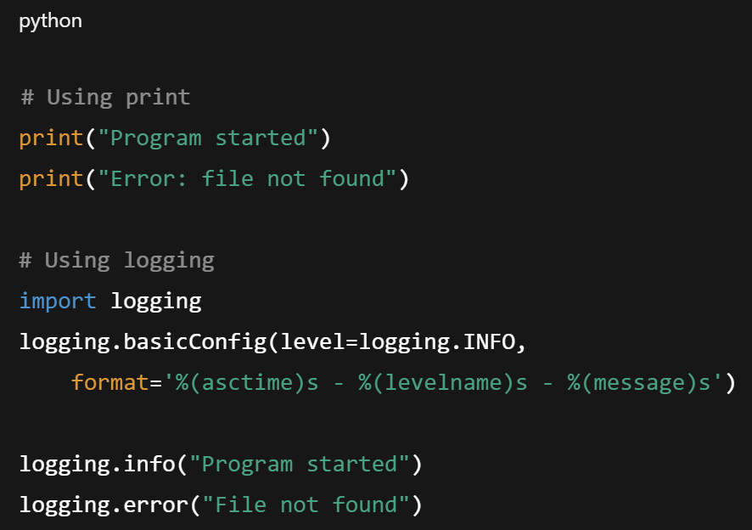
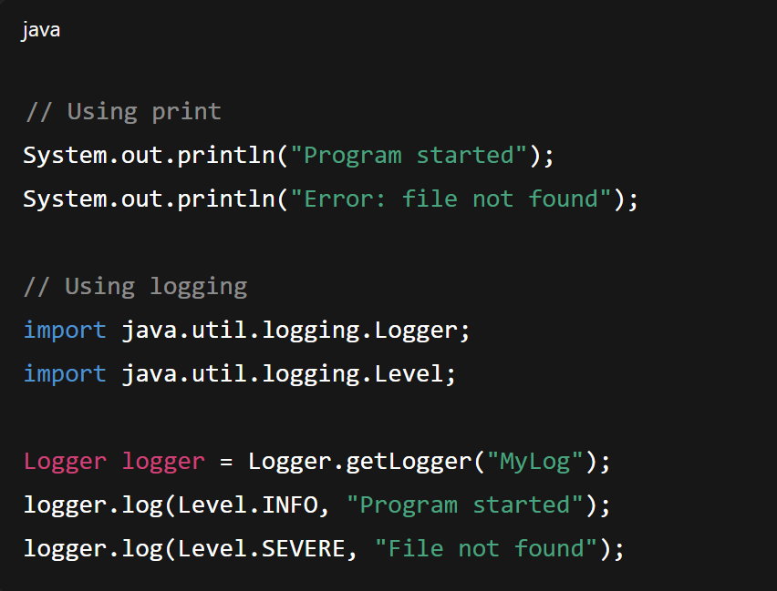
Examples
Python
Java
Print shows plain text only.
Logging adds time, severity, and context automatically.
Print is basic and not configurable.
Logging provides levels and can be redirected to files/servers.

Slide 35
Project folder structure

Slide 36
What is Project folder structure?
A project folder structure defines how files and directories are organized in a software project. A clear structure improves code readability, maintainability, and collaboration. It also ensures that developers can easily find, modify, and manage project files and helps maintain consistency across different projects and teams.
Importance of a Proper Folder Structure
Organization: Groups related files together for clarity.
Scalability: Supports adding new modules or features without confusion.
Collaboration: Team members can navigate and understand the project easily.
Maintainability: Simplifies debugging, testing, and updating code.
Best Practices: Encourages adherence to coding standards and version control.

Slide 37
Common Folder Structure in Software Projects
src/ – Contains source code files.
docs/ – Documentation related to the project.
tests/ – Test scripts and unit tests.
assets/ – Images, CSS, JavaScript, or other static files.
config/ – Configuration files, environment variables, and settings.
lib/ or vendor/ – External libraries or dependencies.
build/ or dist/ – Compiled code or production-ready files.
README.md – Project overview and instructions.
.gitignore – Specifies files to exclude from version control.

Slide 38
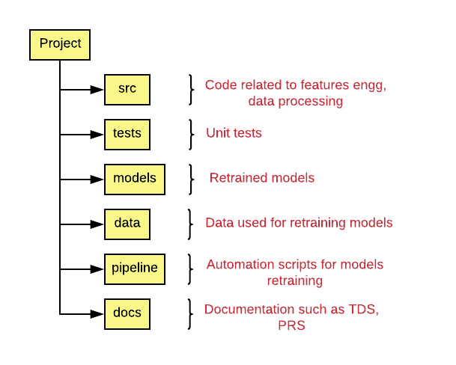
Example of Data Science Project Folder Structure

Slide 39
Best Practices for Folder Structure
Keep related files together and separate different concerns (code, tests, docs).
Use consistent naming conventions for directories and files.
Avoid deeply nested folders; keep it simple and intuitive.
Include a README and proper documentation for orientation.
Keep configuration and sensitive data separate from source code.
Maintain version control compatibility by excluding unnecessary files.

